Slide 1


CAPSTONE PROJECT PORTFOLIO
AI Systems for Corporate Legal — Compliance & Employee Wellbeing
Two production-focused GenAI MVPs built end-to-end under the LTIMindtree capstone collaboration: - LA BOT — a retrieval‑augmented legal advisory and template‑safe document generator - Corporate Employee Wellness Bot — privacy‑first, behavior‑driven wellbeing risk detection
LA BOT
Wellness Bot
Legal Advisor Bot: cited Q&A, clause-safe DOCX drafting, audit trail
Aggregate‑first wellbeing detection using passive behavioral signals and explainable risk scoring
Santhosh Rajinikanth (T-9982)— M.Tech (AI & ML), VIT Chennai | Industry collaboration: LTIMindtree, Chennai

Slide 2
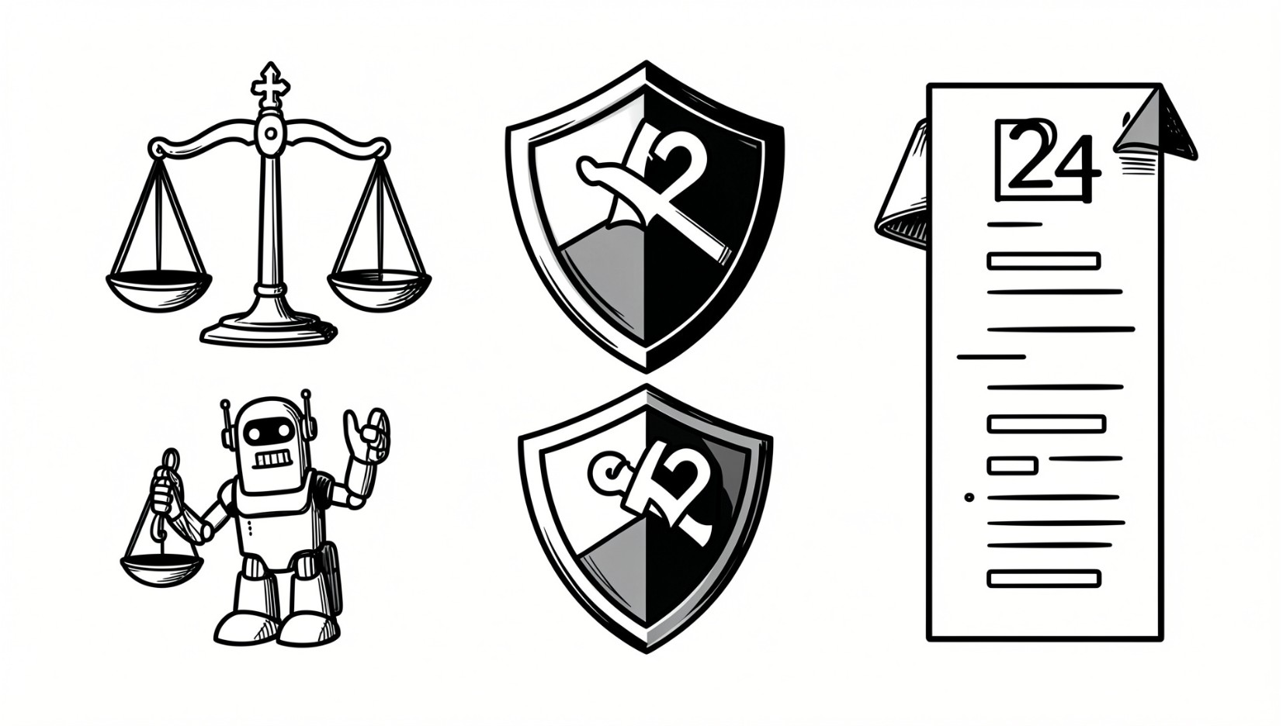
LA BOT — Legal Advisor Bot
A retrieval‑augmented Q&A and document generation system focused on Indian corporate IT compliance. Designed to reduce legal team overload, speed decisions, and ensure traceable, auditable outputs.
Key Problems
Core Objectives
Safety & Governance
Rapid regulatory change (IT Act, DPDPA, RBI/SEBI circulars) outpaces in‑house capacity; off‑the‑shelf LLMs hallucinate citations.
Ground answers in retrieved law with inline citations; refuse when insufficient basis; generate template‑locked documents with audit logging.
Configurable confidence threshold (default 0.55) enforces explicit "insufficient legal basis" fallback and persistent "PENDING HUMAN LEGAL REVIEW" watermark on drafts.
Design highlights
Hybrid retrieval: dense (Chroma) + sparse (BM25) with RRF merging
Context‑only answers from Claude with inline act/section citations
Template‑safe drafting: python-docx over vetted NDA/SLA/DPA templates
Audit trail: template/version/params + review gate for every draft

Slide 3


LA BOT — Tech Stack, Data Sources & Outcomes
Technical Architecture
Data & Evaluation
Backend: Python 3.11, FastAPI, Pydantic v2
Retrieval: ChromaDB (dense) + rank_bm25, RRF merge
Embeddings: all-MiniLM-L6-v2 (local)
LLM: Gemini 3.7 Flash dependency isolated to answer-stage
Frontend: React + Tailwind (chat UI & doc-gen form)
Guardrails: scope checker, PII redactor, rate limiting
Build-stage uses realistic stub documents; production ingests official govt PDFs with idempotent chunking and auto-reindexing. Evaluation uses 20+ curated queries across DPDPA, IT Act sections, Companies Act, and contract clauses — includes deliberate no-answer tests to validate fallback.
Outcome: cited, confidence-gated Q&A + template‑safe DOCX drafting with audit logs; deployable MVP on free‑tier infra.

Slide 4

Corporate Employee Wellness Bot — Problem & Approach
Privacy‑first behavioral signal analysis to detect early wellbeing risk. The system prioritizes proportionality, consent, and explainability so HR can intervene appropriately without punitive monitoring.
Problem
Quarterly surveys and exit interviews are lagging; roster strain and passive signals often go unmonitored until attrition or performance loss occur.
Passive Signals
Screen‑time trends, shift irregularity (day/night mix), and keystroke dynamics (timing only) form multi‑factor inputs — content is never captured.
Explainability
Gradient‑boosted risk model with SHAP‑style attribution shows which factors drive a flag, enabling targeted, proportionate interventions.
Compliance
Aggregate‑first dashboards with individual opt‑in only; design aligned to DPDPA 2023 principles: purpose limitation, minimization, and proportionality.

Slide 5
Wellness Bot — Tech Stack, Datasets & Pilot Outcomes
Stack & Components
Datasets & Pilots
Signal capture: lightweight local agent (active‑window time, app‑switch counts, keystroke timing — never content)
Feature engineering: pandas + time‑series features (typing latency variance, session gaps, circadian irregularity)
Model: XGBoost/LightGBM risk scorer with SHAP explainability
LLM layer: Gemini 3.5 flash lite converts scores + drivers into plain‑language HR summaries
Storage: PostgreSQL (aggregates) + time‑series store for raw windows
Model calibration uses WESAD and SWELL‑KW public datasets and keystroke fatigue studies. Pilot with volunteer, opt‑in cohort collects real telemetry under DPDPA‑aligned consent to refine thresholds and privacy safeguards.
Expected deliverables: benchmarked feature extraction pipeline, explainable aggregate HR dashboard, and consent‑driven pilot rollout aligned to DPDPA guidance.
Next steps
Run pilot with opt‑in cohort and finalize thresholds
Complete legal compliance checklist and SIEM/data‑governance integration
Package audit logging & review‑gate for enterprise deployment
Santhosh Rajinikanth | LTIMindtree Capstone Program

